Slide 1

Basic Web
MVC, ASP.NET Core, Razor
JS
HTML
C#
CSS
SoftUni Team
Technical Trainers
Software University
https://softuni.bg

Slide 2
Table of Contents
Model-View Controller (MVC)
ASP.NET Core Framework
  Introduction
  Controllers and Routing
  Views and Razor View Engine
  Models in ASP.NET Core
  Processing Requests
ASP.NET Core Web App – Live Demo

Slide 3
Have a Question?
sli.do
#csharp-fund

Slide 4
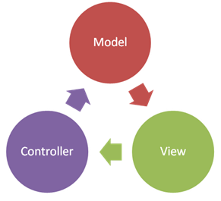
Model – View – Controller
MVC

Slide 5
MVC
Model-View-Controller (MVC) is an architectural pattern
Separates an application into three main groups
  Views, controller, models
Helps to achieve separation of concerns
Delineation of responsibilities makes the application:
  Easy to read and understand the logic (better structure)
  Easy to implement new functionalities and extensions
  Easy to test and debug
5

Slide 6
Controller (Logic)
The core MVC component – holds the logic
Processes the requests and renders the views
A set of classes that handles:
  Handling data submitted by the user
  Overall application flow
  Application-specific logic (business logic)
Every controller has one or more "actions"
6

Slide 7

View (User Interface)
Defines how the application's
user interface (UI) will be displayed
May support master views (layouts)
May support sub-views
(partial views or controls)
May use templates to
dynamically generate HTML
7

Slide 8
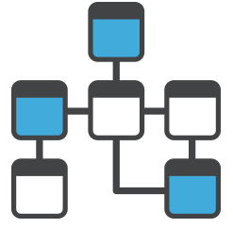
Model (Data)
Set of classes that describes
the data we are working with
Rules for how the data can
be changed and manipulated
May contain data validation rules
Often encapsulates data
stored in a database
8

Slide 9
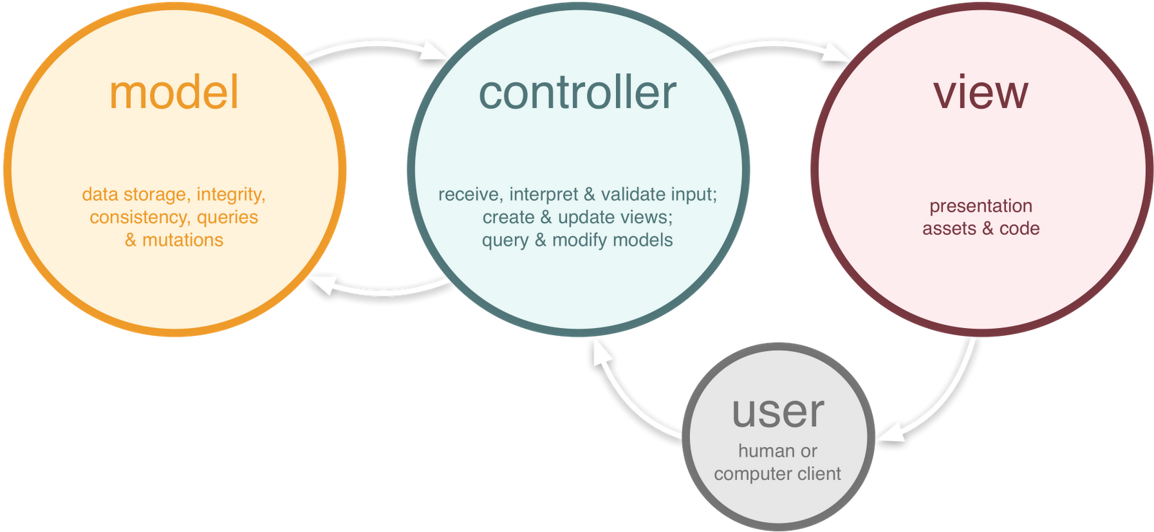
MVC

Slide 10

Web Application MVC Framework for C# and .NET
ASP.NET Core Framework

Slide 11

Web Framework
Framework == set of resources and tools, used as
base for building a software system
Web application framework - provides a standard
way to build and deploy Web applications
Designed to support the development of
  Web services
  Web resources
  Web APIs
11

Slide 12

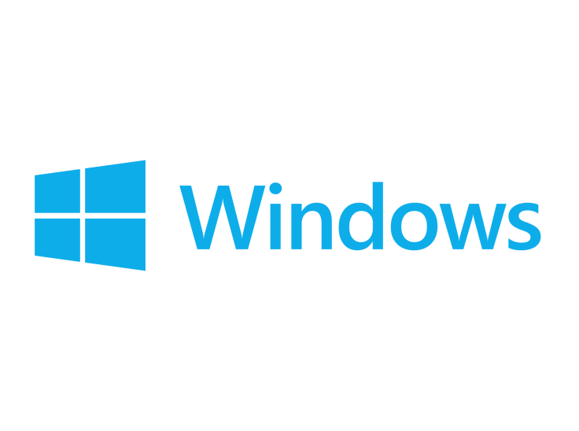

ASP.NET Core MVC
  Lightweight, open-source and highly testable Web
  application framework
  Uses the Model-View-Controller design pattern
  Redesign of ASP.NET 4.x
  Cross-platform – targeting the .NET Core platform
    Runs on multiple operating systems
12

Slide 13
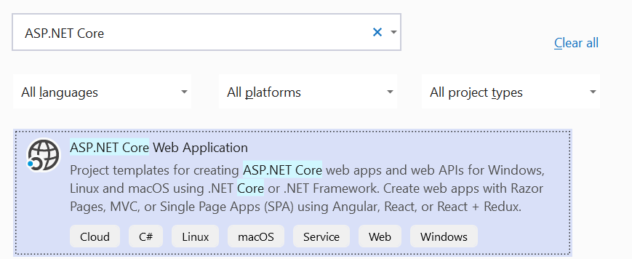
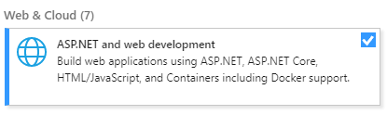
Create ASP.NET Core MVC App: Project Type
Install this in Visual Studio!

Slide 14
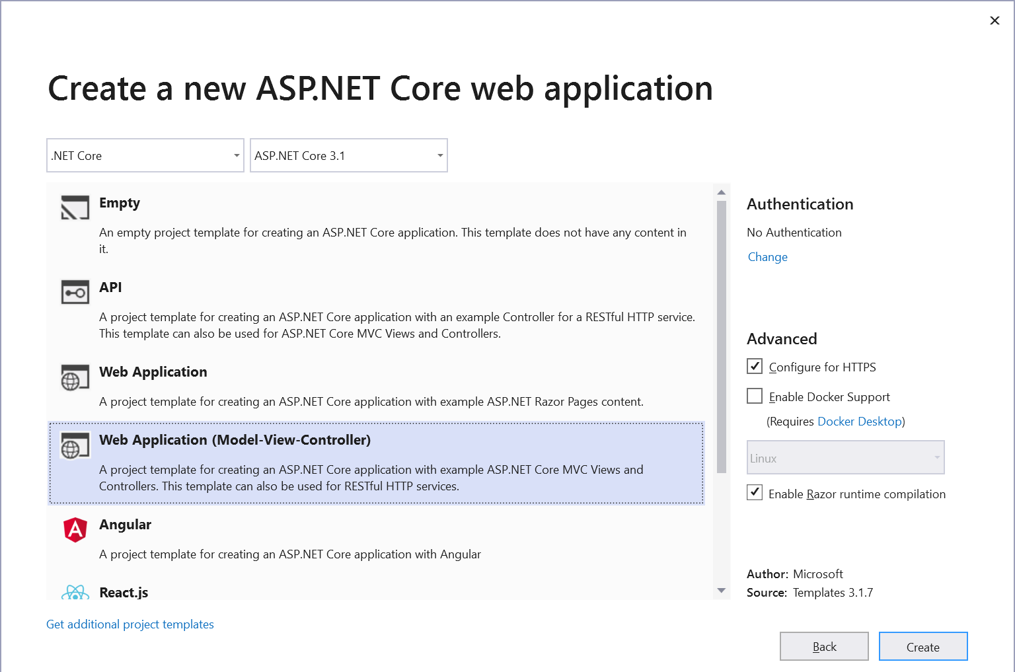
Create ASP.NET Core MVC App: Choose Template
Make sure Authentication is set to "No Authentication"

Slide 15
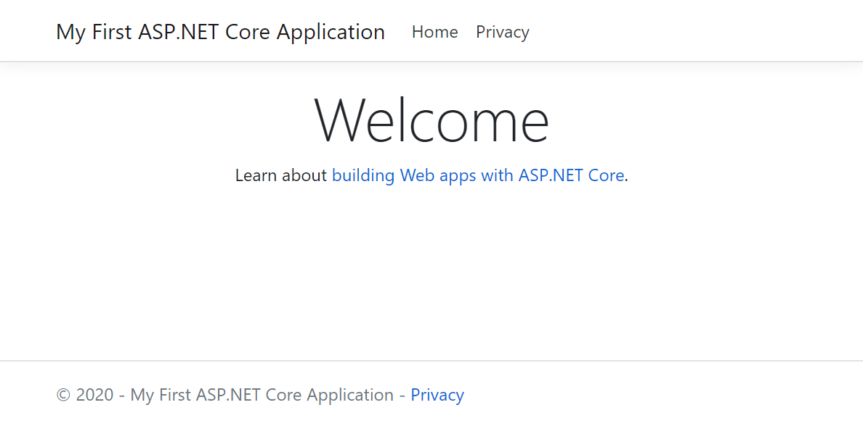
Run ASP.NET Core MVC App
Run the project using [Ctrl + F5] or [F5]

Slide 16
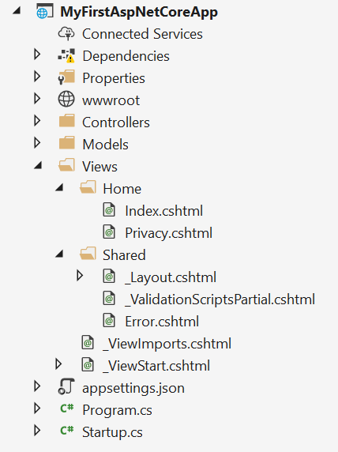
MVC App: What's Inside?
Static files:
CSS styles images, fonts, …
NuGet packages
Controller classes holding actions
Models: entity classes + view models
Views:
HTML templates
for the pages
Shared views:
layout for all pages + partial views
App start files

Slide 17
Controllers in ASP.NET Core
MVC controllers hold logic to process user interactions
The URL /Home/About invokes HomeController → About()
\Controllers\HomeController.cs
public class HomeController : Controller
{
public IActionResult About()
{
ViewBag.Message = "Your application description page.";
return View();
}
}
Controller's methods are called actions
Renders Views\Home\About.cshtml

Slide 18
ASP.NET Core App Routing
Routing is configured within Configure Method in the StartUp Class
Template Matches URL path like:
  /Orders/Details/17
  /Orders/All
Also match the URL path "/", {controller} and {action} parameters have
default values Home and Index
app.UseEndpoints(endpoints => {
endpoints.MapControllerRoute(
name: "default",
pattern: "{controller=Home}/{action=Index}/{id?}");
});
Route values are determined by splitting the URL into segments
Id route parameter is optional

Slide 19
Views in ASP.NET Core
Views render the HTML code for the invoked action
Views combine HTML with C# code
ASP.NET MVC uses Razor view engine
  Markup syntax for embedding server-based code into
  webpages
  Syntax is a consists of Razor markup, C#, and HTML
  Files generally have a .cshtml file extension
By convention Action and View name are identical

Slide 20
The "Razor" Syntax (Templating Engine)
\Views\Home\About.cshtml
@ { … } inserts C# code block
@{
string title = "About";
}
<h2>@title</h2>
<h3>@ViewBag.Message</h3>
<p>Use this area to provide additional information.</p>
@Something
prints a C# variable
Everything else is HTML code

Slide 21
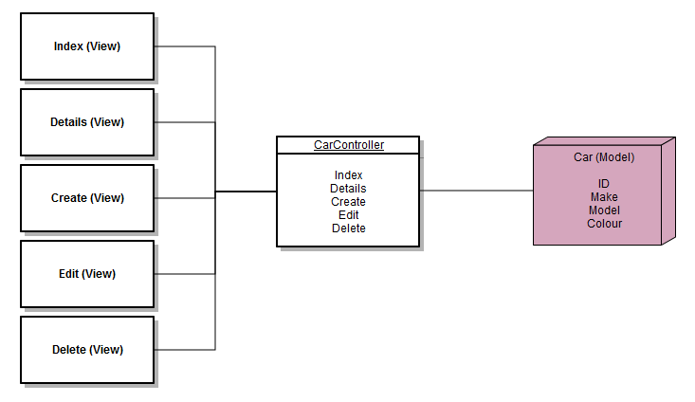
Models in ASP.NET
Represent the state of the application
May be used by controllers to pass data to Views
Determine how the data will be stored

Slide 22
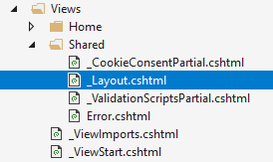
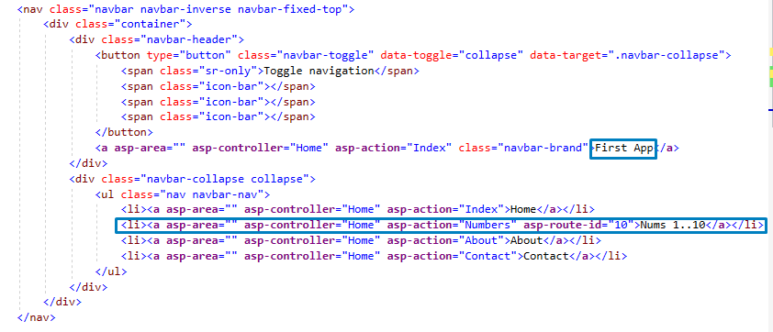
Example: Number Generator
Change the _Layout.cshtml file in your projects

Slide 23
Process GET Request
We need a functionality to handle our interaction
Create new action method Numbers in HomeController.cs
The id from URL will be passed as parameter
IActionResult represents the base action result
public IActionResult Numbers(int id)
{
int numbersRange = id;
ViewBag.numbersRange = numbersRange;
return this.View();
}
ViewBag is used to pass data to the View

Slide 24
Create View
Create а new Razor View Numbers.cshtml in Views\Home folder
Use Razor View Engine to generate appropriate title
and render unordered HTML list of numbers
@{
ViewBag.Title ="Nums 1 .. " + ViewBag.numbersRange;
}
<h2>@ViewBag.Title</h2>
<ul>
@for (int i = 1; i <= ViewBag.numbersRange; i++)
{
<li>@i</li>
}
</ul>

Slide 25
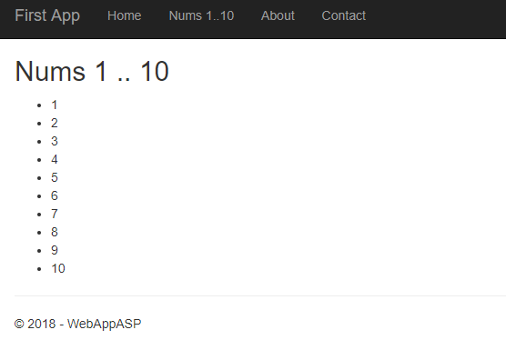
Nums 1 .. 10
After pressing Nums 1 .. 10
we should be
able to see this

Slide 26
Process POST Request
Add Form at the end of the Numbers.cshtml, so we can post
the number range we want to generate
We must specify the request method
The name must be exactly the same as the action parameter name
<form method="POST">
<input type="text" placeholder="New number" name="number" />
<input type="submit" />
</form>

Slide 27
Process POST Request
Create new Action method in Home Controller
If we want to procces POST request, we must use [HttpPost] attribute
Both actions have identical names, but parameter types are different
[HttpPost]
public IActionResult Numbers(string number)
{
int numbersRange = int.Parse(number);
ViewBag.numbersRange = numbersRange;
return this.View();
}
Use the same ViewBag property name to pass the data

Slide 28
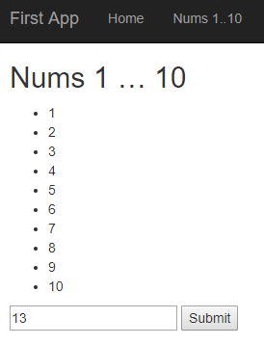
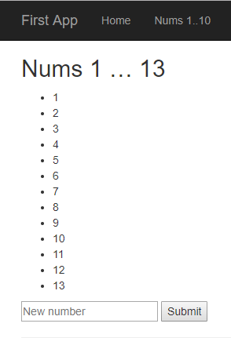
Number Generator
Now the app should be able to generate custom range

Slide 29

Summary
…
…
…
Framework is a set of resources
and tools for app building
MVC is an architectural pattern
Views and Controllers
functionalities
View Engine (like Razor) is used to
create dynamic Web pages

Slide 30
Questions?
Notes:
30

Slide 31
Trainings @ Software University (SoftUni)
Software University – High-Quality Education, Profession and Job for Software Developers
  softuni.bg, about.softuni.bg
Software University Foundation
  softuni.foundation
Software University @ Facebook
  facebook.com/SoftwareUniversity
Software University Forums
  forum.softuni.bg
31
Notes:
31

Slide 32

License
This course (slides, examples, demos, exercises, homework, documents, videos and other assets) is copyrighted content
Unauthorized copy, reproduction or use is illegal
© SoftUni – https://about.softuni.bg
© Software University – https://softuni.bg
Notes:
32

